Slide 1
TMD AGS Gradacac
Die Casting Tooling and Machining Plant
Die Casting Tooling & Machining Plant,
Sarajevska 62, Gradacac, Bosnia & Herzegovina
Our employees our greatest value!

Slide 2
History of TMD AGS Gradacac
1954
1973
1998
2008
2012
2013
The company has founded in 1954, production of agricultural machinery. Company formerly known as TMD Gradačac.
TMD Gradačac has belonged to the company FAMOS. The company, had 800 different products under licenses from ZF and Daimler Benz.
TMD Gradačac has privatized. A part of the TMD converted in TMD AGS d.o.o.. Assembly of agricultural machinery.
The company has changed owner structure. New orientation of the company : start with aluminum die-cast foundry.
TMD AGS d.o.o. and Wagner AG Waldstatt make Joint Venture Company:
WAGNER Automotiv d.o.o.
TMD AGS d.o.o. start with foundation of tool shop and aluminum machining plant.
Our employees our greatest value!

Slide 3
Location
The company is 30 km away from Highway (Zagreb - Belgrade)
The nearest airports are:
- Tuzla distance 70 km, cca. 1,2 hour driving on local roads
- Sarajevo distance 180 km, cca. 3,5 hours driving on local roads
- Belgrad distance 200 km, cca. 2,0 hours driving on highway
- Zagreb distance 260 km, cca. 2,5 hours driving on highway
Our employees our greatest value!

Slide 4
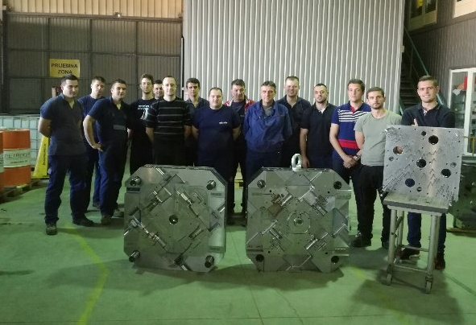
Employees
Tool shop and machining plant founded at the end of 2013 with 4 employees, now TMD AGS have over 35 employees.
Strategy is to invest in knowledge, 11 our employees has University degree.
DEPARTMENT | No. employees
Production | 20
Quality | 3
Technology | 7
Procurement | 1
Sales | 1
Maintenance | 3
Our employees our greatest value!

Slide 5
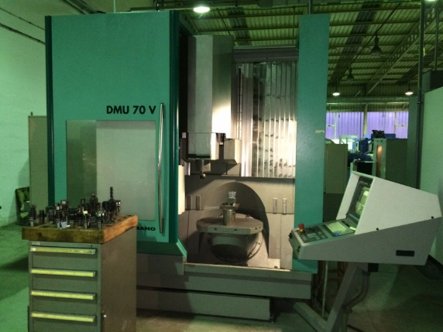
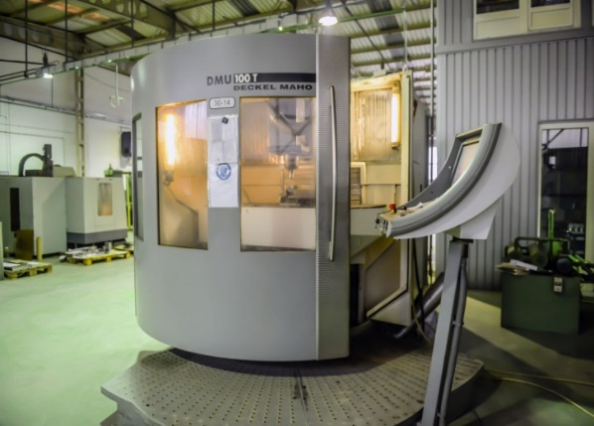
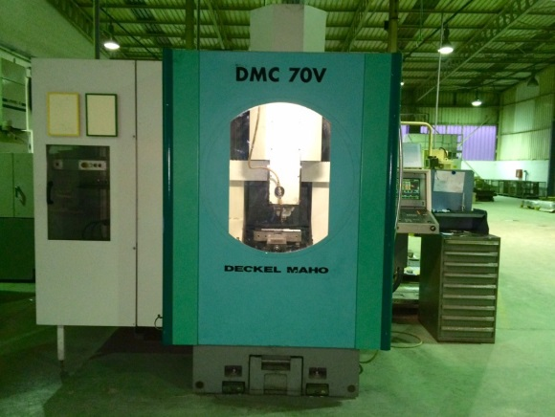
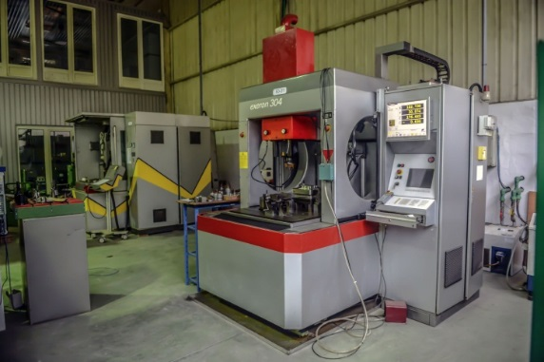
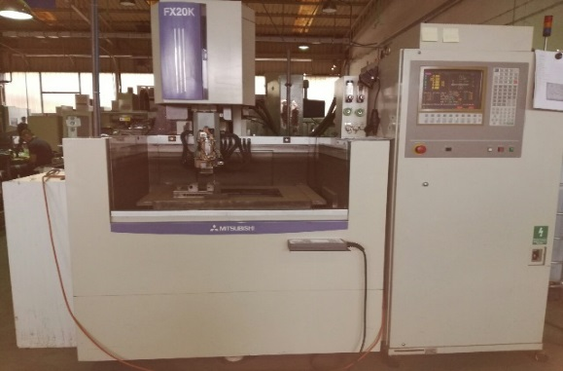
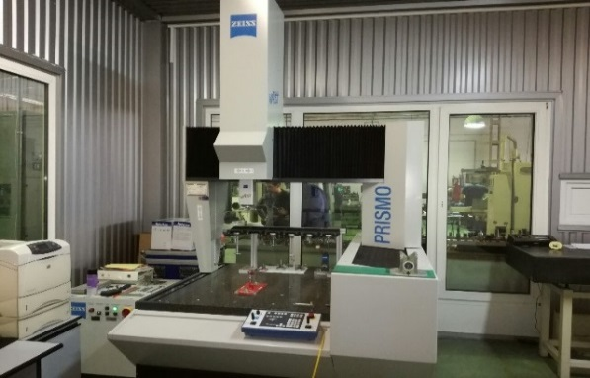
Tool Shop & Machining Plant Equipment
TMD AGS is equipped with all necessary machines & equipment for production:
Die casting tools
Trimming tools, stamping and press tools and other type of tools
Serial machining automotive parts
Our employees our greatest value!

Slide 6
Tool Shop & Machining Plant Equipment
Type of machine | Brand | No.
5-axis machining centers | Dekel Maho DMU50, DMU60, DMU70, DMU100 | 4
3-axis vertical m. centers | Mikron 400, 600, 710, 800, Mazak & other | 10
4-axis sink EDM | Exeron 303, 304, Charmilles 350 | 4
5-axis wire EDM | Exeron, Mitsubishi FX20K | 2
Surface grinders | Kikinda Brayant 1000, ZF 300 | 3
Turning machines-driven tools | Spinner, Biglia, Angelini | 4
Machining equipment limitations
Process | Max. X (mm) | Max. Y (mm) | Max. Z (mm)
Milling | 1300 | 750 | 500
Sink EDM | 500 | 350 | 400
Wire EDM | 550 | 400 | 250
Grinding | 1000 | 400 | 300
Turning | ф400 | - | 800
Our employees our greatest value!

Slide 7
Quality
TMD AGS is certified with ISO 9000 & IATF 16949 certificate
Quality equipment installed in TMD AGS:
Coordinate measuring machine Zeiss Prismo Vast X=700, Y=900, Z=500,
Mitutoyo roughness measuring device,
3D Scanner Atos
Micrometers OD-ID, Calipers etc.
Quality equipment. available in Wagner:
x-ray
Spectrometer
Conturograph. etc.
3D Scanner Atos
Our employees our greatest value!

Slide 8
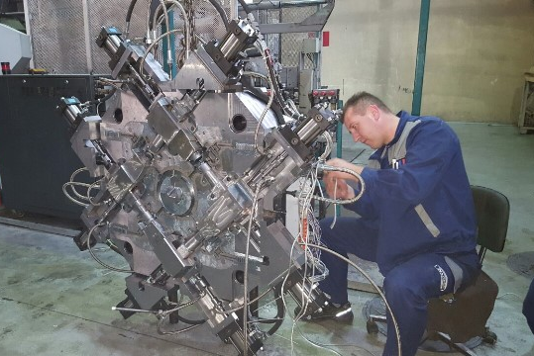
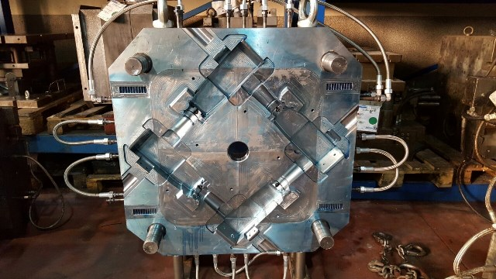
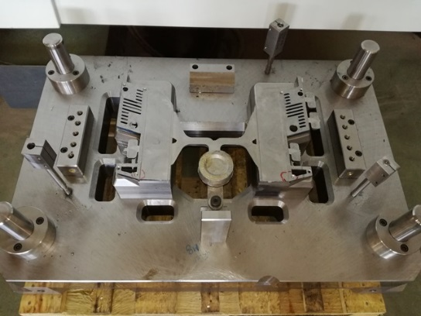
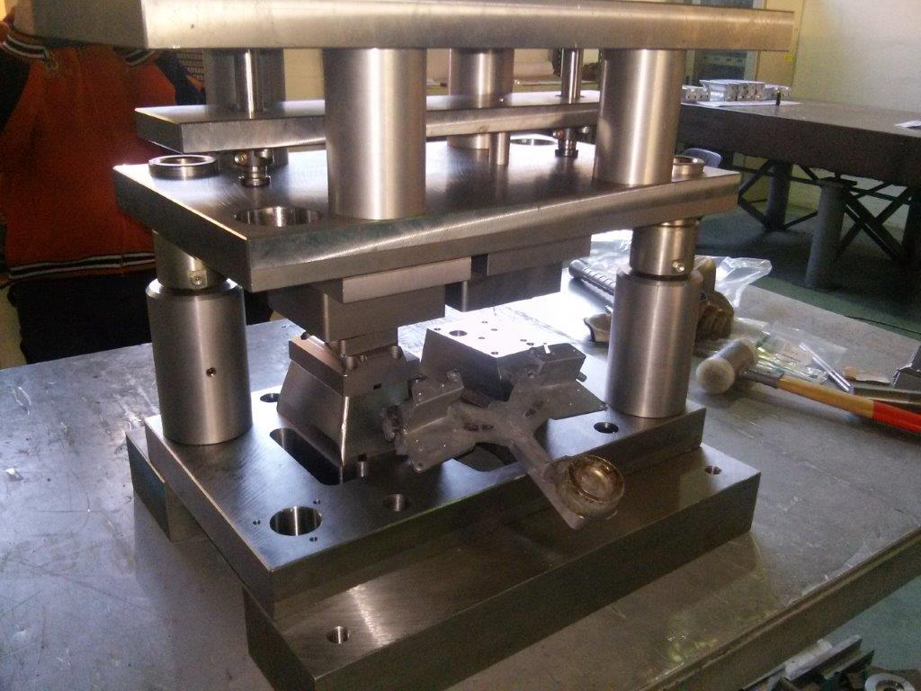
Products-die casting tools & stamping tools
Our employees our greatest value!

Slide 9
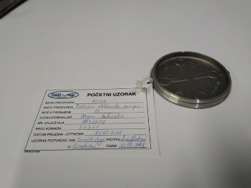
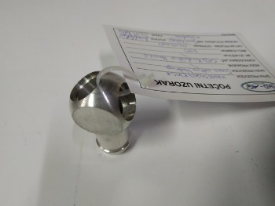
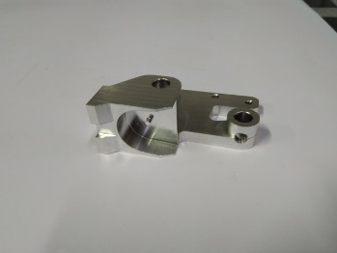
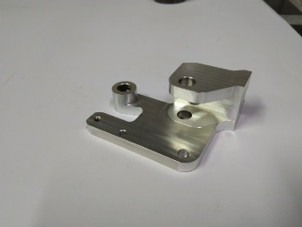
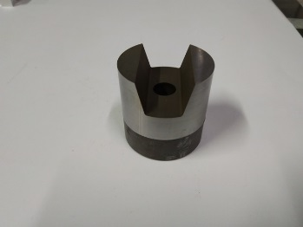
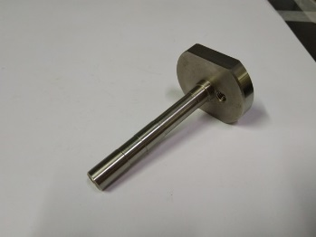
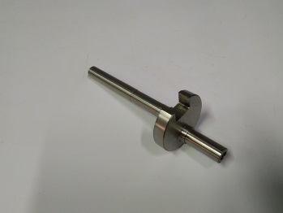
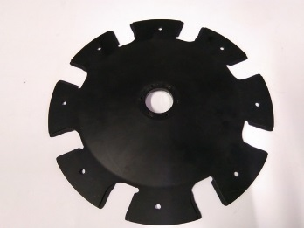
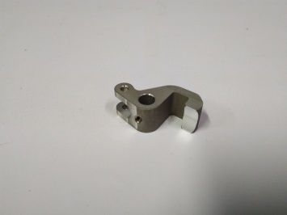
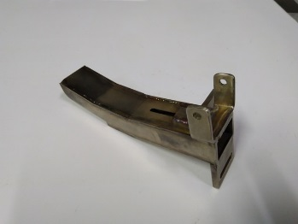
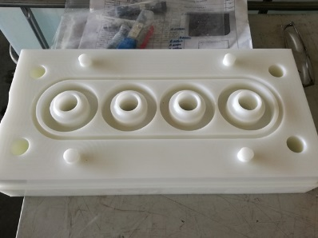
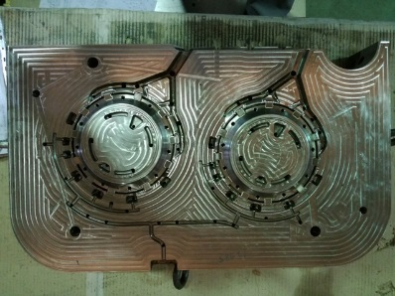
Products-CNC machined parts
Our employees our greatest value!

Slide 10
Our Customers
WAGNER AG Waldstatt, Swiss (direct)
Wagner Automotive, B&H (direct)
Magneti Marelli Srl, Italy (indirect)
BorgWarner Esslingen GmbH , Germany (indirect)
Remus Innovation Gmbh, Austria (direct)
Stobag AG, Swiss (direct)
FFT Produktionssysteme GmbH & Co.KG (direct)
x BorgWarner

Slide 11
Contact Information
TMD AGS d.o.o.,
Adress: Sarajevska 62,
76250 Gradacac,
Bosnia & Herzegovina
Contact:
Enes Bikodusic, Project Manager
Mob.: + 387 (0)61 785 615
Fax.: + 387 (0)35 816 737
E-mail: enes.bikodusic@tmd-ags.ba
www.tmd-ags.ba
Thank you for attention!
Our employees our greatest value!

