Slide 1
Company presentation

Slide 2
Company and branches
Šumer d.o.o.
Location: Ljubečna, Slovenia
Objects:12 982m2
Area: 45 298 m2
Employee: 320
Activity: RRA unit, development of products, machines and devices. Technology of products, processes, production and assembly.
Lendava
Location: Lendava, Slovenia
Objects: 1574 m2
Area: 4732 m2
Employee: 24
Activity: production of plastic components and assembly
1
company
2
services
Srbija
Location : Adaševci, Serbia
Objects : 3600m2
Area : 69 587 m2
Employee : 35
Activity : assembly for electro industry
Šumer d.o.o is a multigenerational family company with 50 years tradition of entrepreneurship and trade. The current sector has started around 1980 with the manufacture of springs. Based on needs and development of technological processes, the company has developed into a systemic supplier and thereby gained new experience in the field of metal and plastic products.
3
products
4
contacts
Slovenska Bistrica
Location : Slovenska Bistrica, Slovenia
Objects : 280m2
Area : 1100 m2
Employee : 4
Activity : turning and drilling

Slide 3
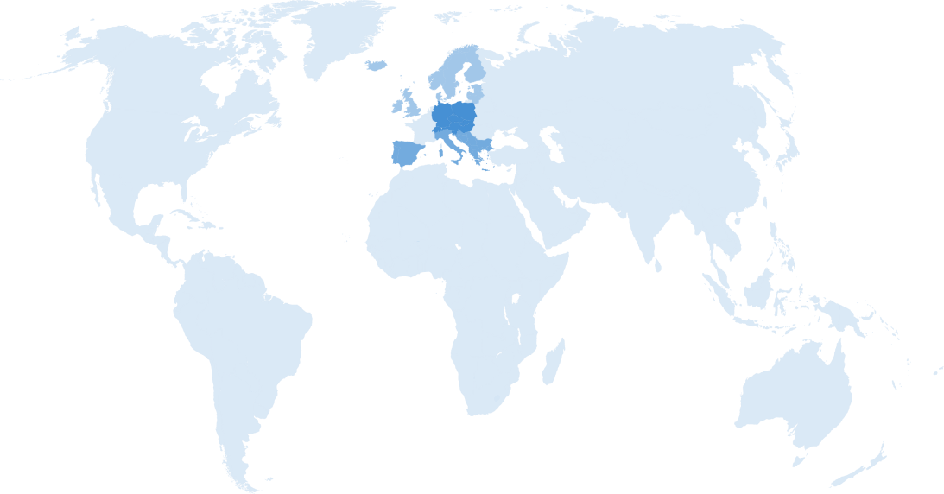
Sales by regions in %
10% North Europe
1
company
40% Middle Europe
2
35% South Europe
services
3
15% Other
products
4
contacts

Slide 4
Sales by industries
With sophisticated technology we supply parts to different industries
1
Other
company
2
Agricultural
White goods
services
Springs and wire bended elements
Hand blenders, beaters, mixers, plastic parts for small and big kitchen appliances
3
products
Electronics industry
Automotive industry
4
Plastic housings for electric consumption meters and switches, metal housings for electro motors…
Wire bended elements, springs, turned parts, different mechanisms, stamped, plastic parts, different items for front and back seats…
contacts

Slide 5
Company turnover
1
company
2
services
3
products
4
contacts

Slide 6
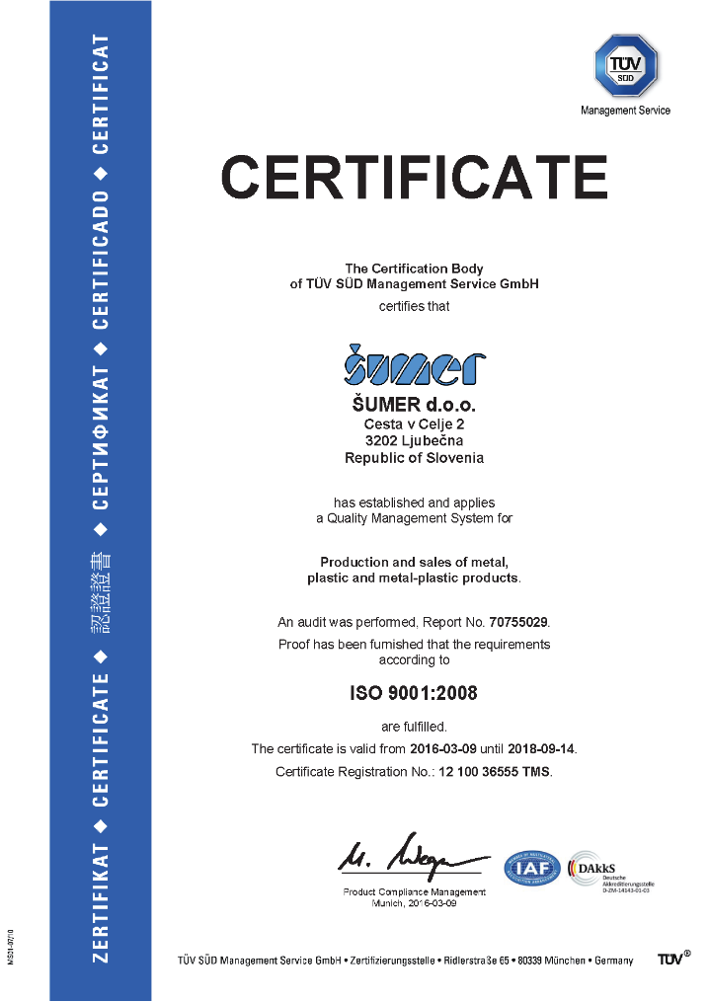
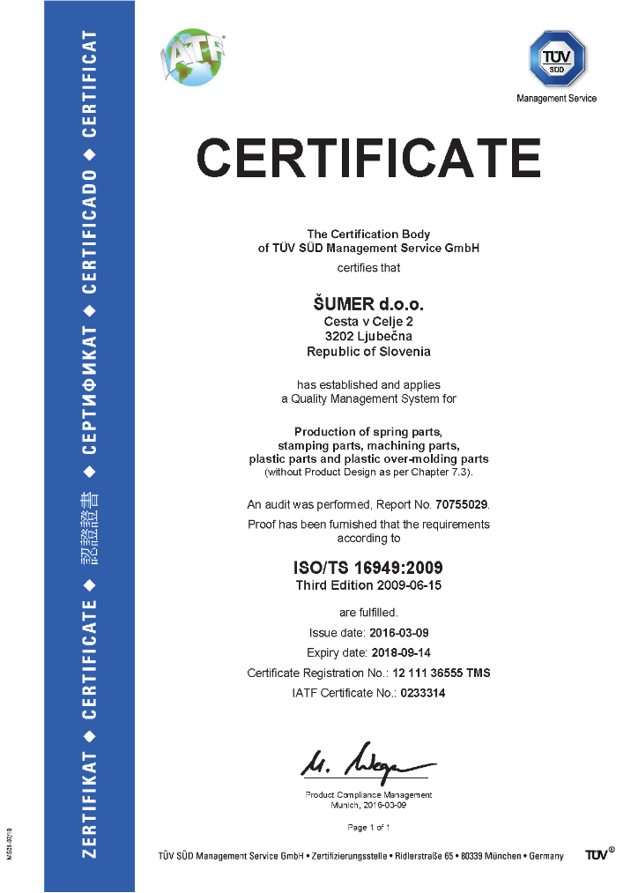
Certificates
Product quality
1
company
2
services
3
products
4
contacts
Since year 1997 is quality of our products certified by ISO 9001. In year 2013 we implemented also standard ISO/TS 16949..

Slide 7
From idea to reality
We can help you along all the steps of your project
1
company
Development
2
services
The company Šumer d.o.o. has its own Development-research Team (RSA) and is entered in the register of research organizations at the Slovenian Research Agency (SRA) under code 2786.
RSA independently plans, implements, verifies and validates tasks according to the program. Research and development activities within the research groups are separated from other development activities carried out in the Šumer company in terms of organisation and costs.
3
Construction
products
4
The development and technology department applies modern CAD-CAM software and closely works with costumers.
contacts

Slide 8
Toolmaking
In the tool making facility we produce tools for metal forming and plastic moulding quickly, efficiently and independently of subcontractors. Together with our development department we produce all the structural components necessary for the construction of new machines and are able to repair all the machines that are essential for the smooth supply of the costumer‘s products.
Our tool making facility produces high quality tools and includes 3 and 5 axes milling centres, CNC controlled turning centres, EDM, wire erosion, grinding machines and others.
1
company
2
services
3
Production
products
New trends on the market, lead us in developing of new products. Besides springs we starts with production of parts from sheet metal, plastic, metal-plastic, production of tools, components for home kitchen appliances, car industry and agricultural industry. Today our products covers all branches of industry from developing stage, production, marketing and servicing of all our products.
4
contacts

Slide 9
Welding
Robot and manual welding.
Welding aluminium, stainless, carbon steel, plastic, silver, titanium and other materials. Welds are tested through various appropriate methods as break-up tests, metallurgical tests, visual inspection of welds.
Metal welding processes: • MIG/MAG, • TIG, • ROV (MMA), • resistance welding, • laser welding (see video).
Plastic welding processes: • ultrasonic welding, • rotational welding, • thermo welding.
1
company
2
services
3
Laser cutting and bending
products
Laser cutting capacities:
• structural steel up to 20 mm, • stainless steel up to 10 mm, • aluminium up to 8 mm, • brass up to 5 mm, • copper up to 5 mm
CNC bending capacities:
• up to 10 mm thickness and 3000 mm length
4
contacts

Slide 10
1
company
2
services
Quality
3
Quality department is responsible for the quality management which ensures that production and the products meet the requirements of the customer.
Our laboratory offers the following tests: • breakout tests, physical properties, • measurements of the hardness, • measurements of the roughness, • measurements of the thickness of the coating, • extensive measurements with 3D measuring machine, • measurements with optical measurement systems, • measurements with projectors and microscopes, • metallurgical tests and • sustainable tests.
products
4
contacts

Slide 11
Diverse technologies
1
company
2
services
3
products
Machining
Treatment
Assembly
Springs
Stamping
Metal-plastic
Plastic
4
Production of standard and customized springs and wire bended elements.
Stamped and deep drawn parts
Over-moulded semi-products and final metal-plastic products
Plastic components and final products
Turned and milled parts.
Materials:
Steel
Stainless steel
Bronze and Brass
Other special materials
Heat treatment and surface treatment:
Hardening,
Carbonitriding
Annealing
Tempering
Quenching
Aging
Normalizing
Stress relieving
Assembling components:
Hand blenders,
DC motors,
Contacts,
Magnet activators,
Hinges,
Safety devices,
Electric fuses
contacts

Slide 12
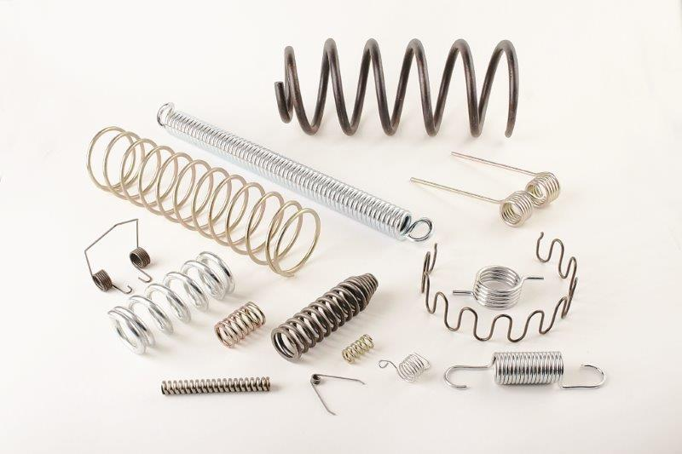
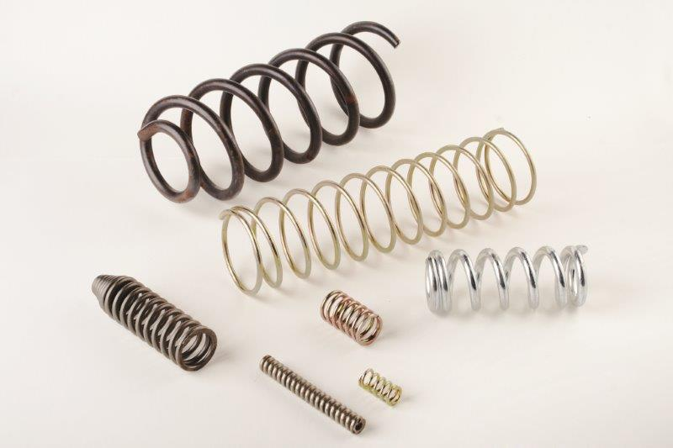
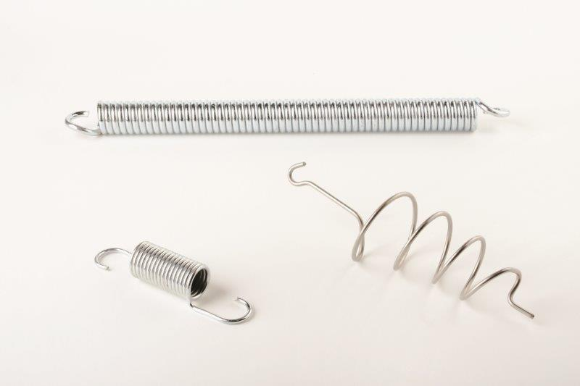
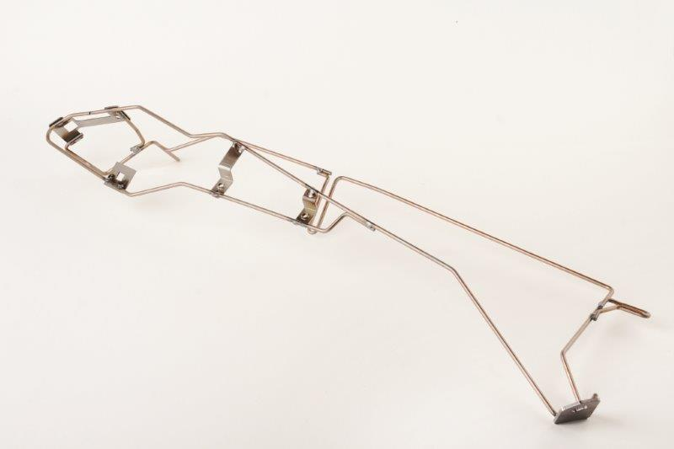
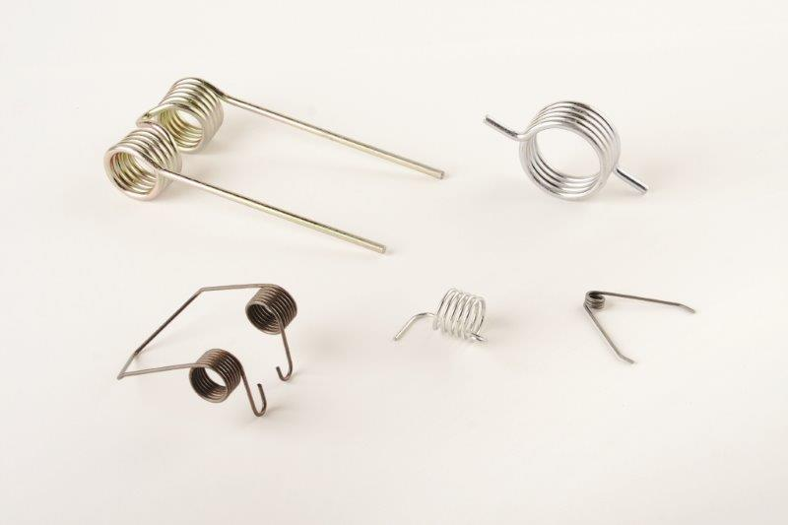
Springs and curved elements
Standard types of springs: • compression springs, • tension springs, • torsion springs, • double torsion springs, • leaf springs, • curved elements.
Shapes: • round, • flat, • ellipse, • rectangular, • other.
Materials: • patented spring wire SH, DH, SL, SM,… • galvanized spring wire SH, DH, SL, SM,… • tempering spring steel, • oil tempered spring steel alloy for high
Dynamic loads (VD SiCr, VD CrV, FD SiCr), • stainless steel spring (X12CrNi177), • drawn steel wire unsuspended all the
qualities.
1
company
2
Dimensions in range 0,05 mm to 25 mm. We also offer thermal and surface treatments and coatings.
services
3
products
4
contacts

Slide 13
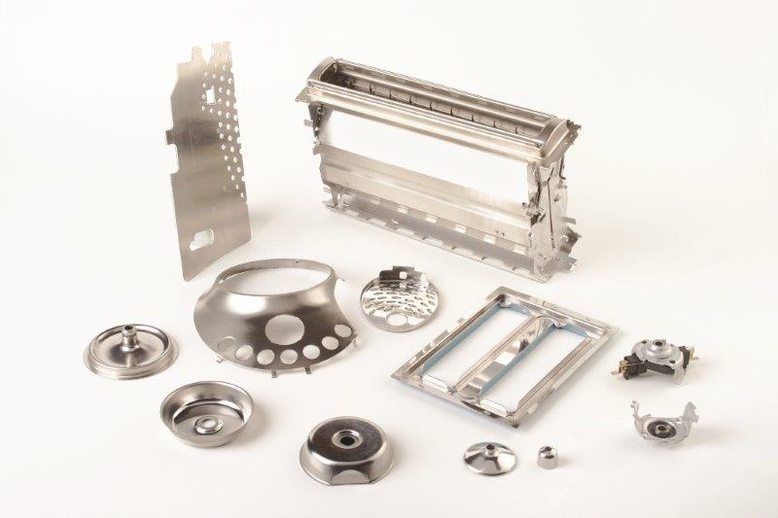
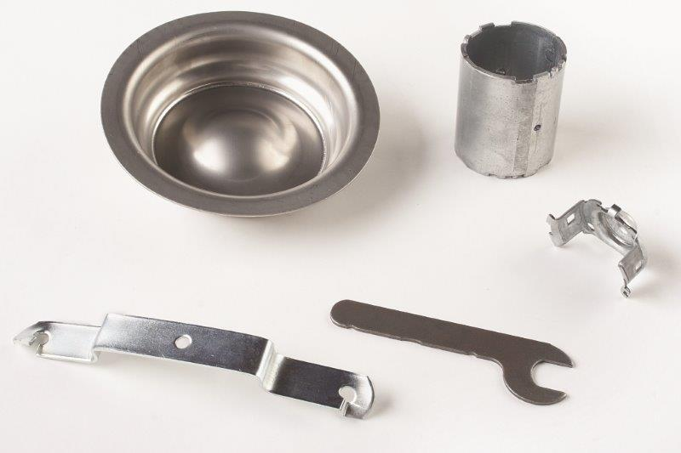
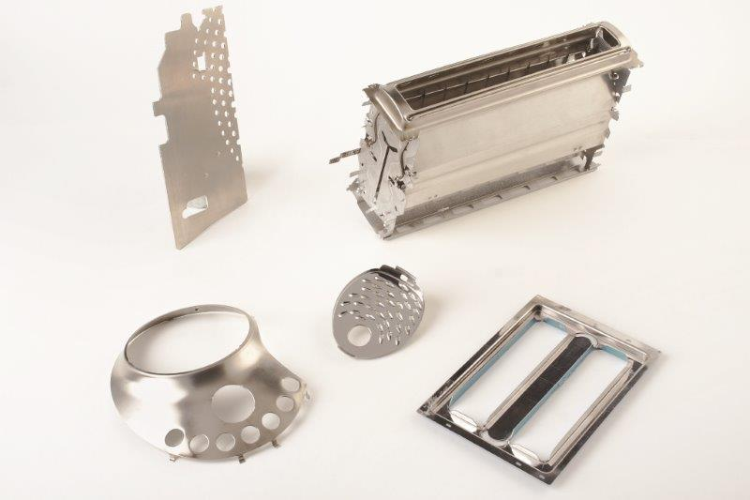
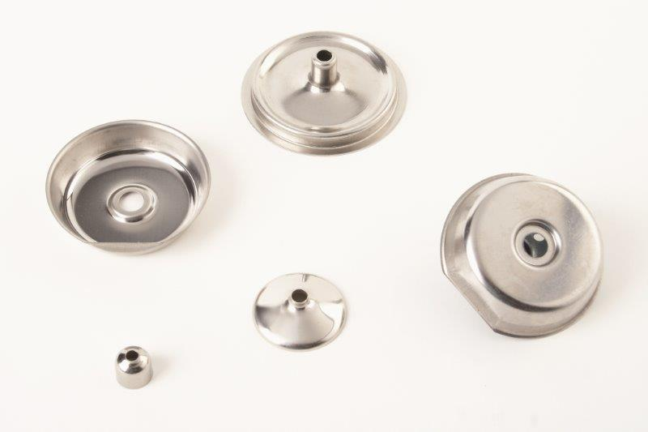
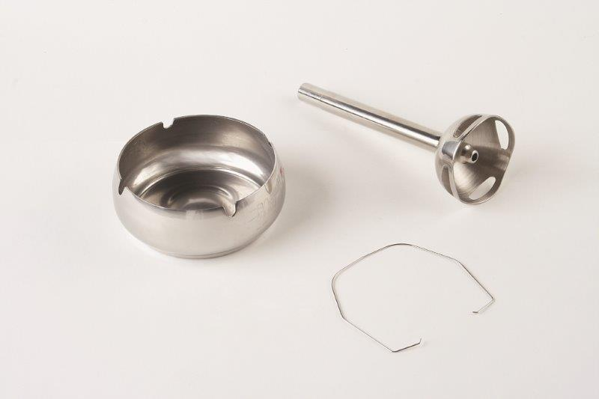
Stamped and deep drawn parts
Stamping department is equipped with pressing machines with capacity from 5 to 500 tons.
Materials: • stainless steel, • aluminium, • steel, • non-ferrous metals, • other special materials.
1
company
2
services
3
products
4
contacts

Slide 14
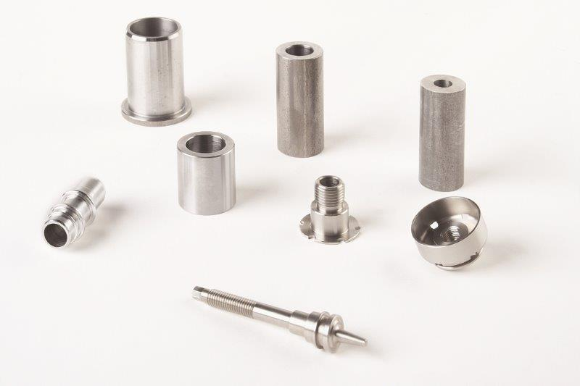
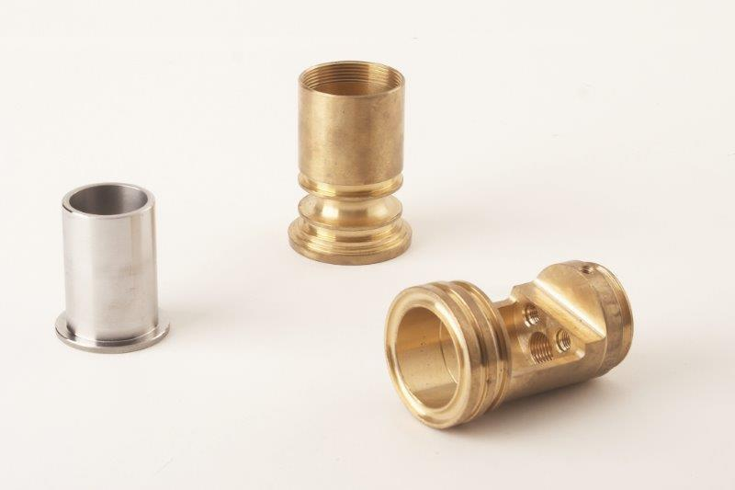
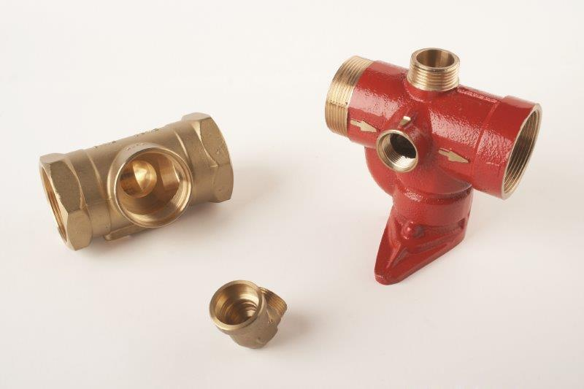
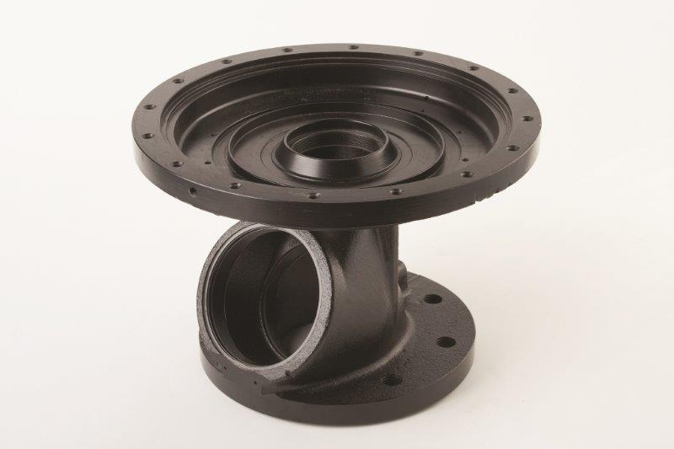
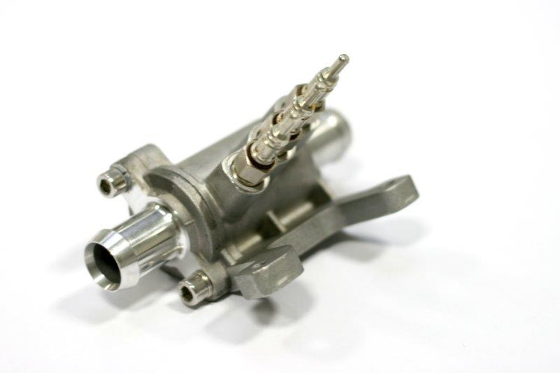
Machining
Machining department is equipped with:
CNC turning centres with sub-driven spindles, automatic feeders,
3 and 5 axes milling centres with single and double working tables,
grinding machines.
We can process turned parts with a maximum diameter 450 mm and serial turning from rods up to a diameter 65 mm.
Machine capacity: • automatic feed: 3 mm to 65 mm, • piece investment: 65 mm to 300 mm, • processing castings and forgings of all sizes.
Materials: • steel, • stainless steel, • non-ferrous metals, • other special materials.
1
company
2
services
3
products
4
contacts

Slide 15
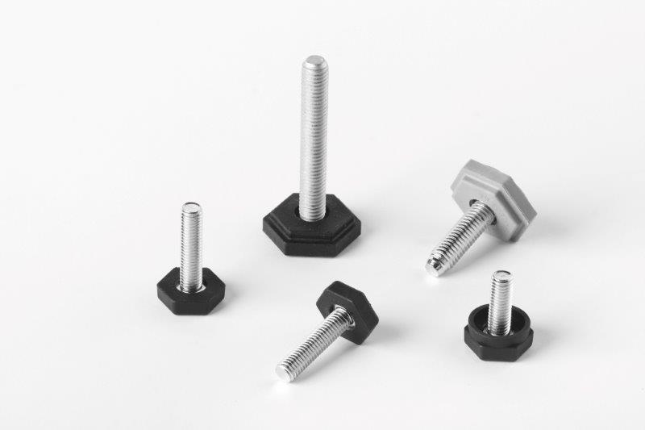
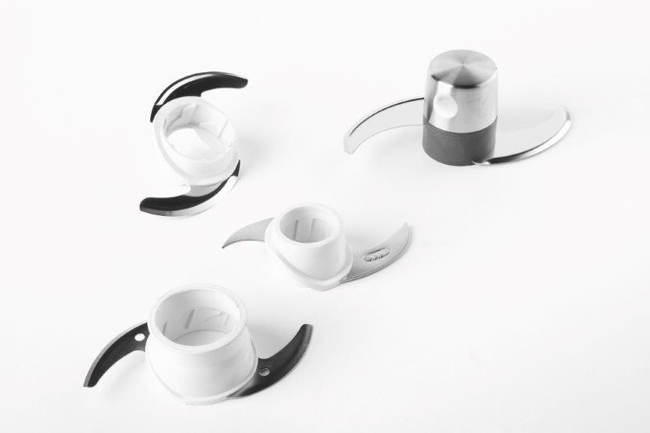
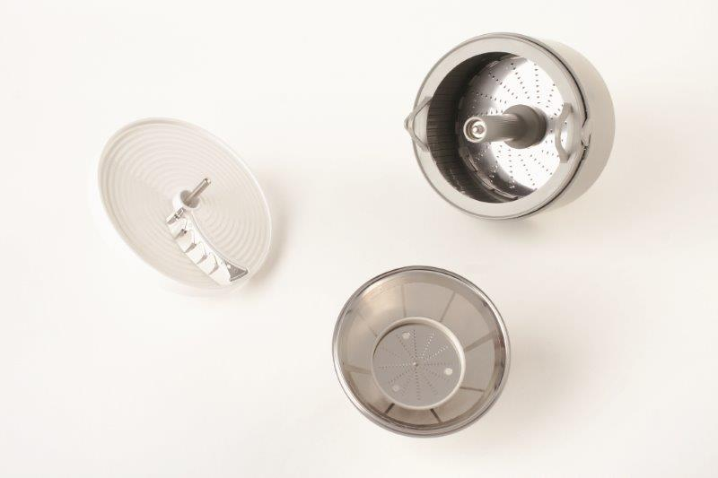
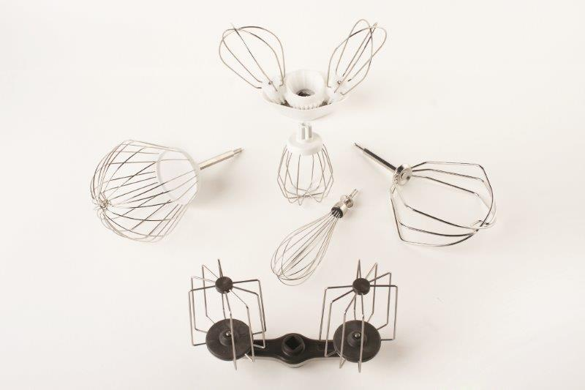
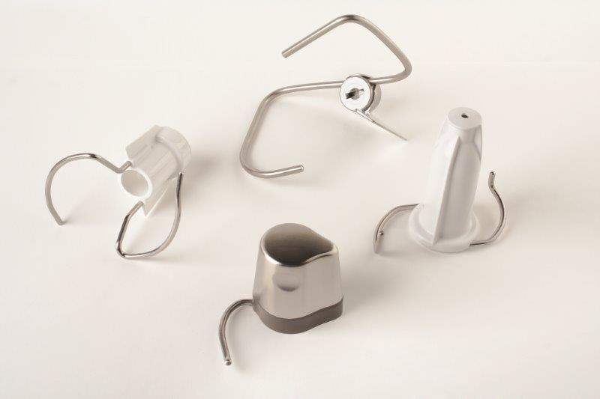
Metal - plastic
With great experiences in over-moulding technologies we are reliable partner to many reputable OEM‘s in home kitchen appliances industry.
Technical data: - clamping force: 35 - 300 T
Materials:
PP, POM, ABS, PC, PS, SEBS, TPE and others.
1
company
2
services
3
products
4
contacts

Slide 16
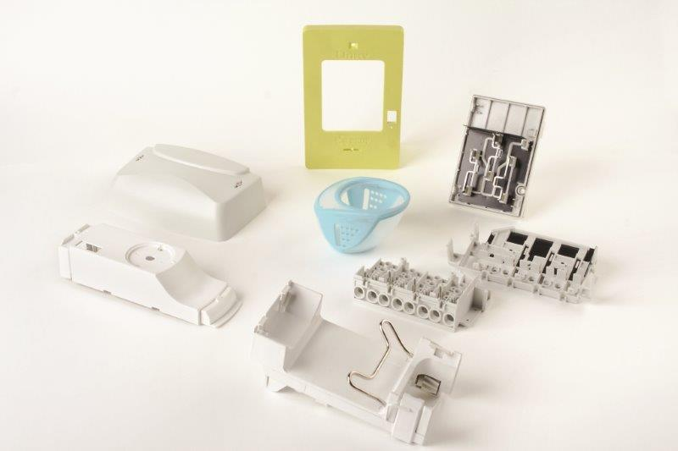
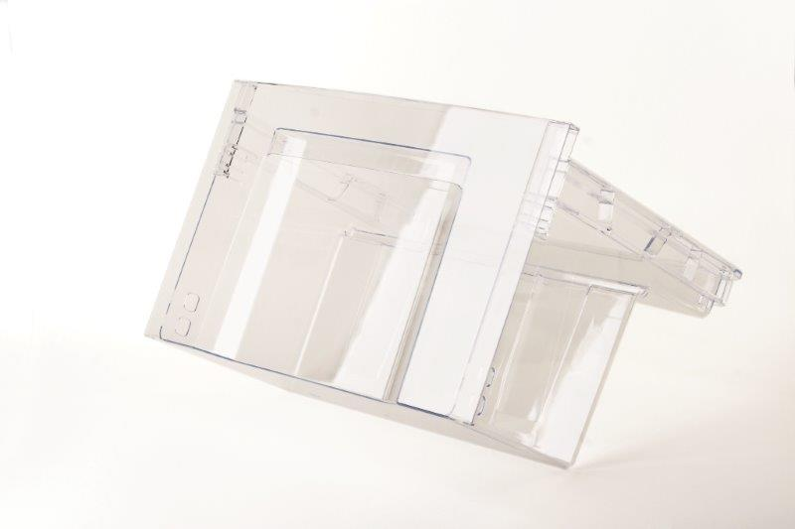
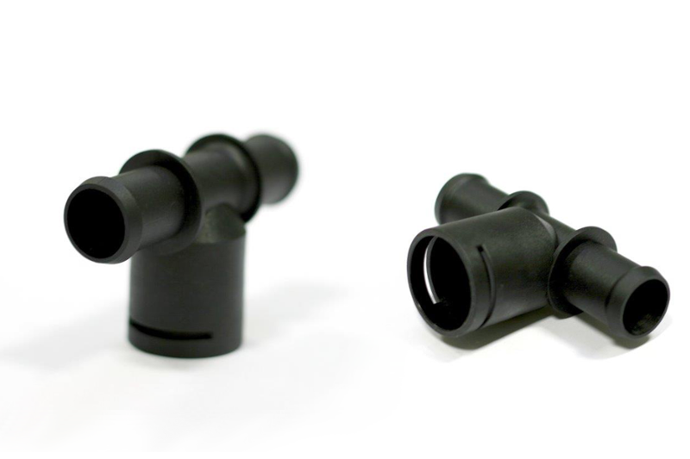
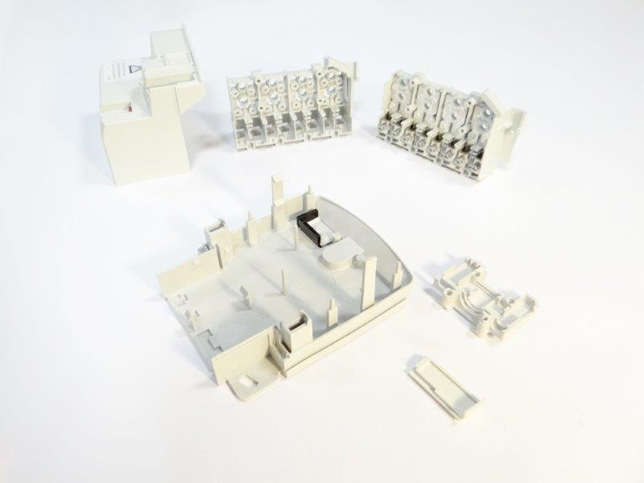
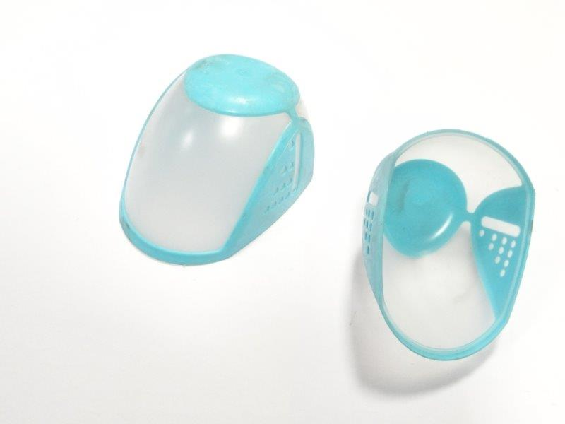
Plastic
We offer injection moulding, two component injection moulding and ultrasonic plastic welding.
Technical data: - clamping force (plastic): 35-1000 T Materials:
PP, POM, ABS, PC, PS, SEBS and others
Based on our comprehensive experience and knowledge, we can advise you on tool manufacturing and develop as well as machine the entire tool. Moreover, we carry out the adequate tests with all the associated extensive measurements and bring your ideas to reality.
1
company
2
services
3
products
4
contacts

Slide 17
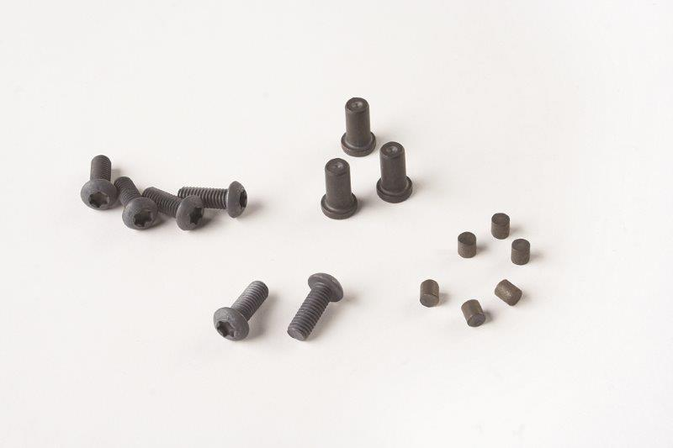
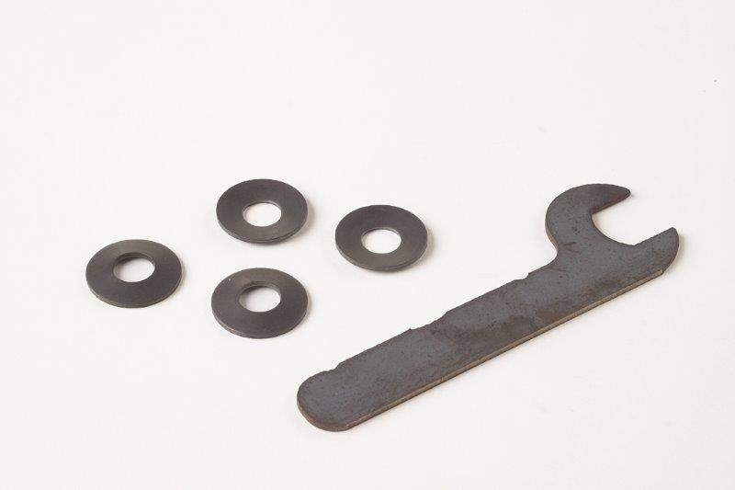
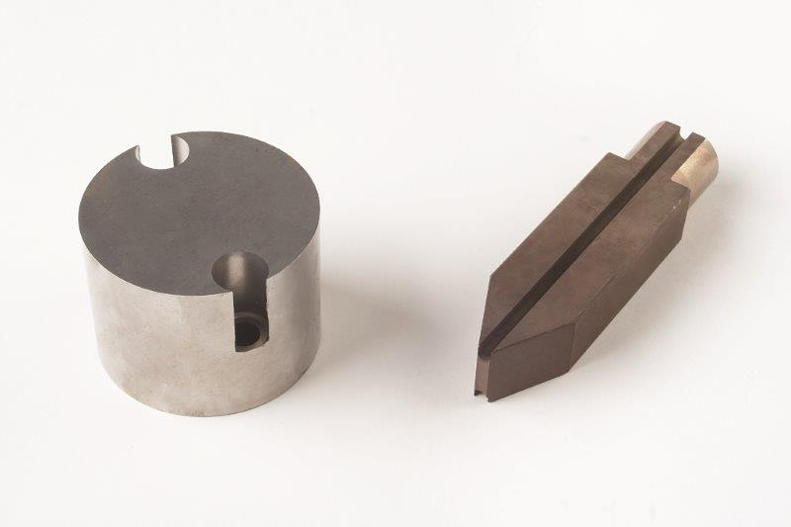
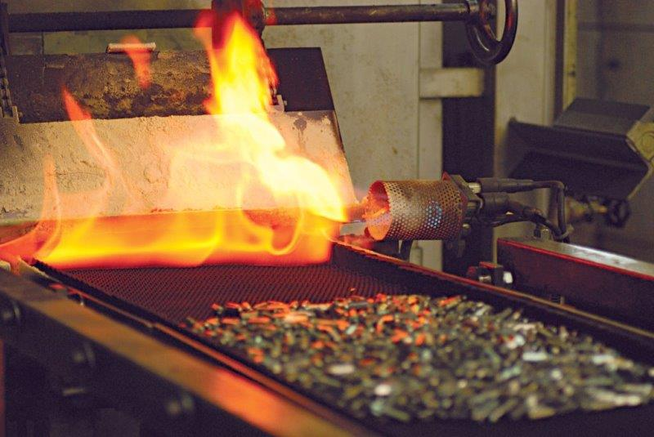
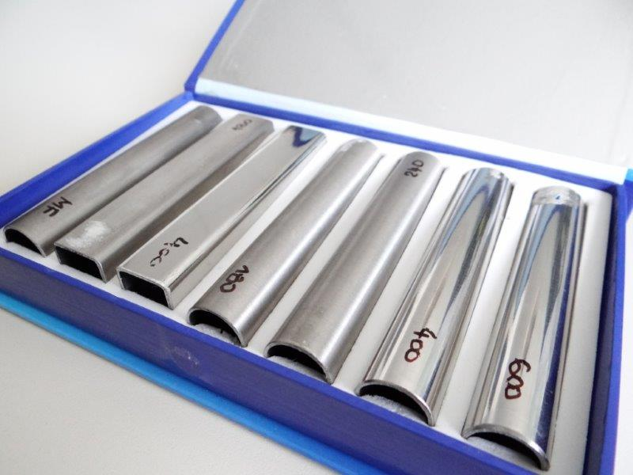
Heat treatment and surface treatment
Technologies in Heat treatment:
• Hardening,
• Carbonitriding,
• Annealing,
• Tempering,
• Quenching,
• Aging,
• Normalizing,
• Stress relieving.
Capacity of flow furnace is from 50 to 150 kg/h.
Technologies in surface treatment: • Shot peening, • Sand blasting, • Intensive ultrasonic washing, • Polishing, • Deburring, • other finishing operations.
1
company
2
services
3
products
4
contacts

Slide 18
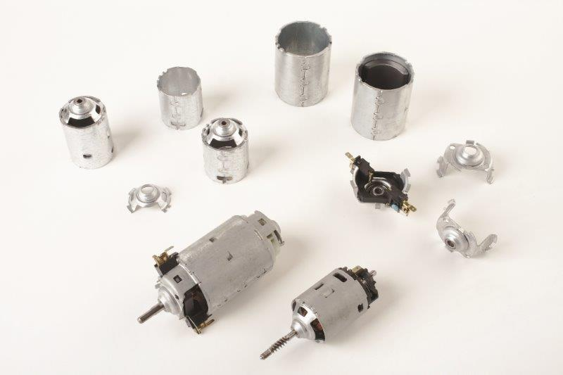
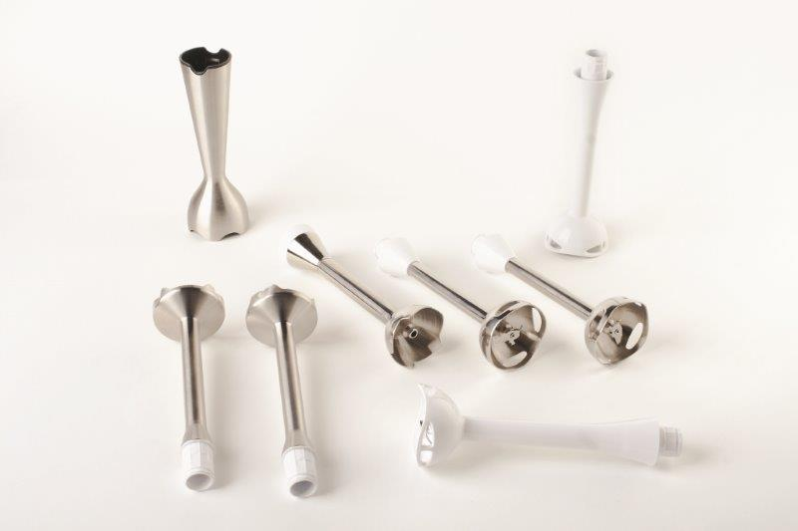
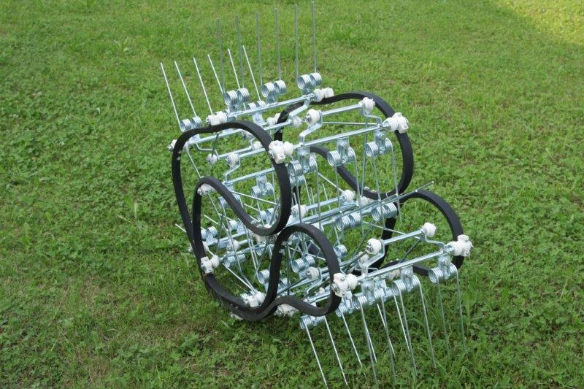
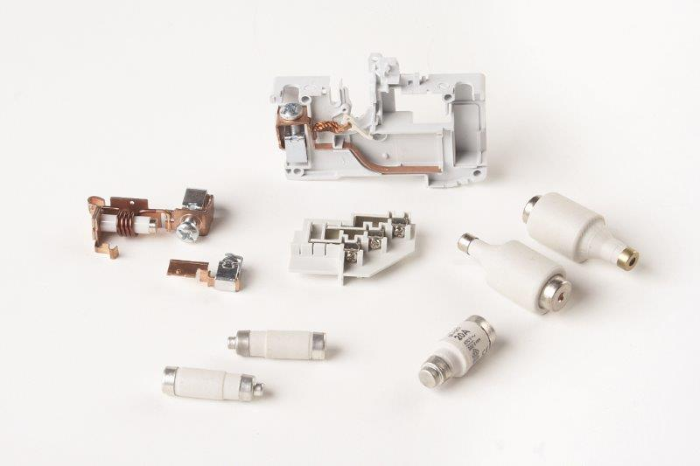
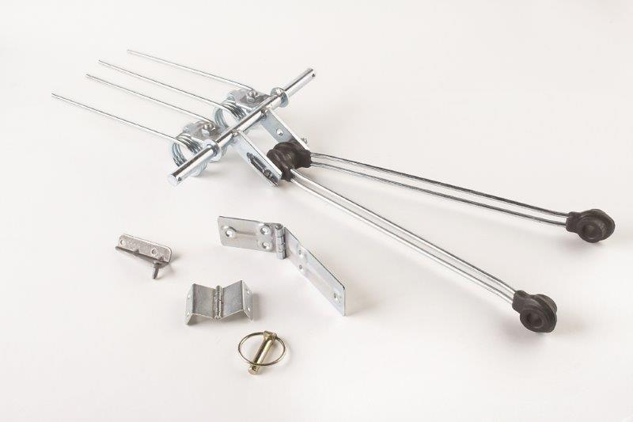
Assembly
Assembly is made manually, with manipulators, robots and assembly tools and fixtures, control devices with online transferring controlled data to the customer server.
Examples of assembly components: • Hand blender foot, • DC motors of all sizes, • Contacts, • Magnetic activator, • Hinges, • Accessories for mixing and mashing, • Accessories for spinning and cutting, • Multi-wire mixer kit,
• Electric consumtion meters
• Electric safety swithes
• Electric fuses • other products.
1
company
2
services
3
products
4
contacts

Slide 19
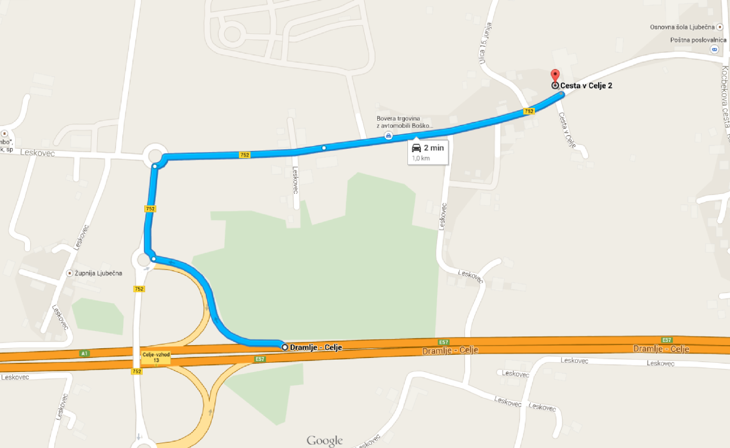
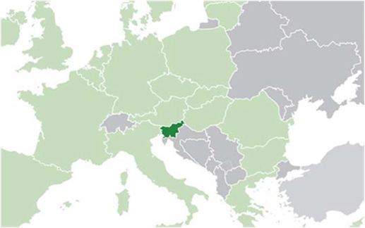
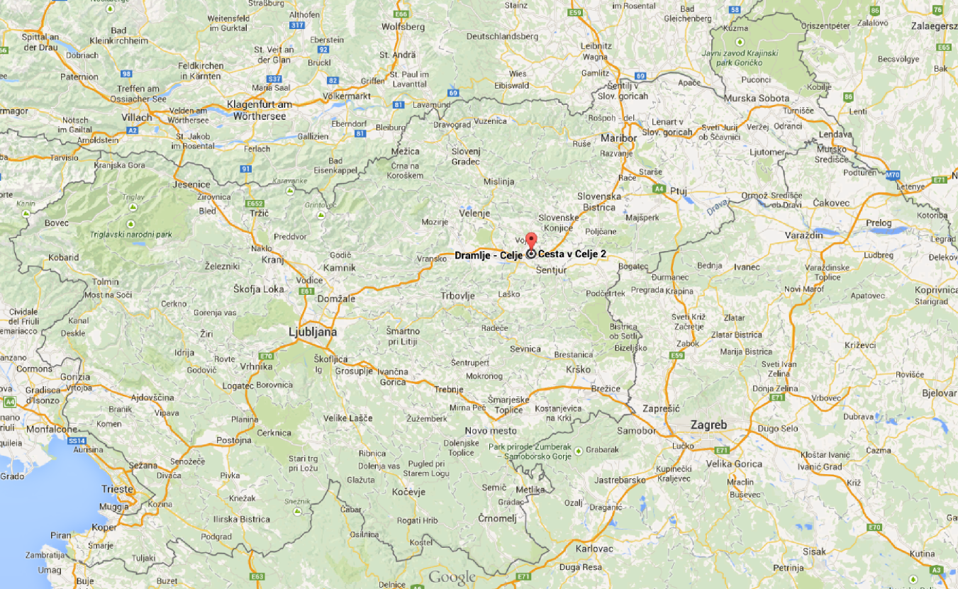
Contact details
Cesta v Celje 2, 3202 Ljubečna
Slovenia
1
+386 3 780 6210
info@sumer.si
www.sumer.si
company
2
services
3
products
4
facebook.com/www.sumer.si
contacts
linkedin.com/pub/šumer-d-o-o/a9/a5/948
https://plus.google.com/+SumerSiKovinoplastikaKovinskiIzdelkiVzmeti/

Slide 20
Thank you for your attention!

